Slide 1
Movies Ontology

Slide 2
Introduction
The movies ontology is designed to represent and describe various aspects of the movie industry. It aims to capture essential information about movies
Titles
Genres
Release years
Countries
Languages
Production Company
Persons such as
Actor
Director
Writer

Slide 3
Visual Representation

Slide 4
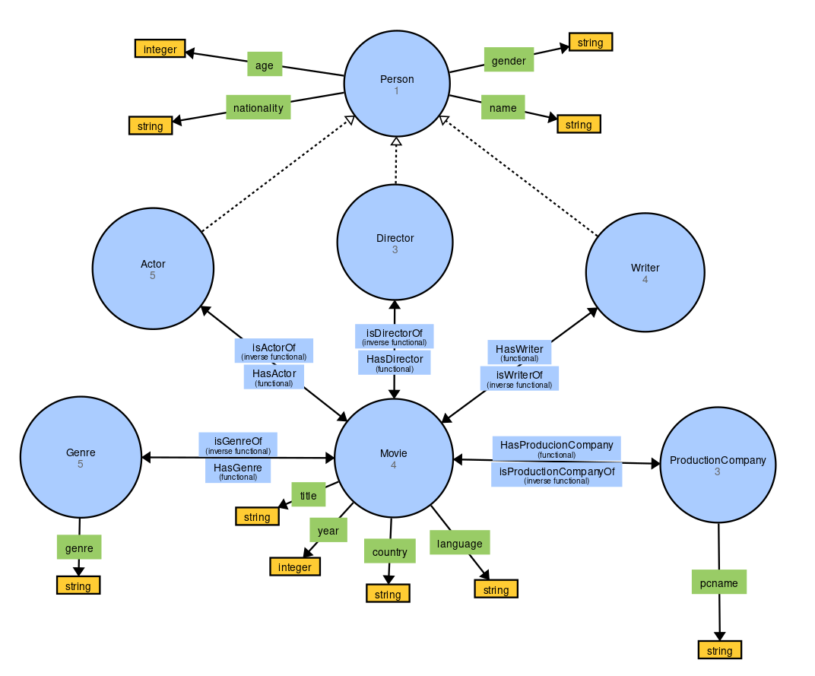

Slide 5
OntoGraf

Slide 6
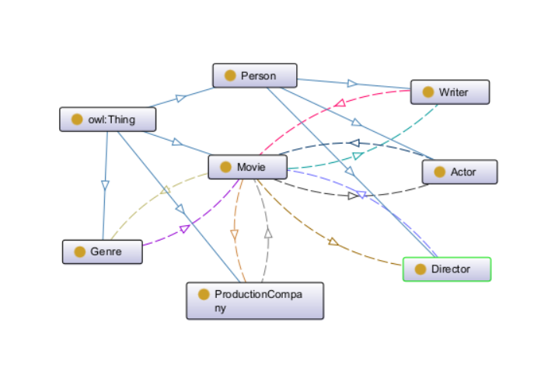

Slide 7
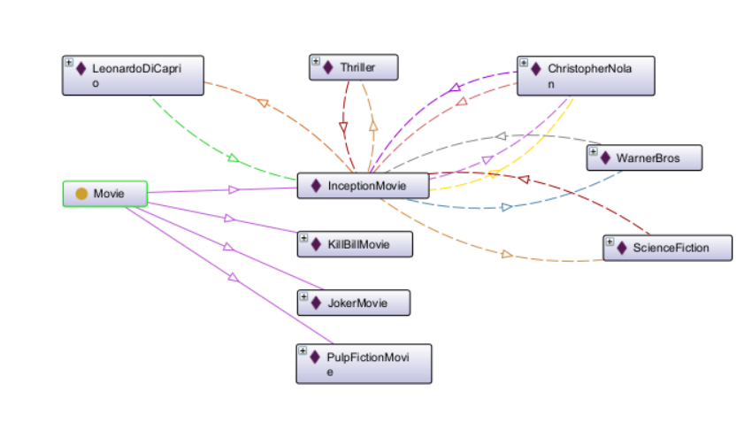

Slide 8
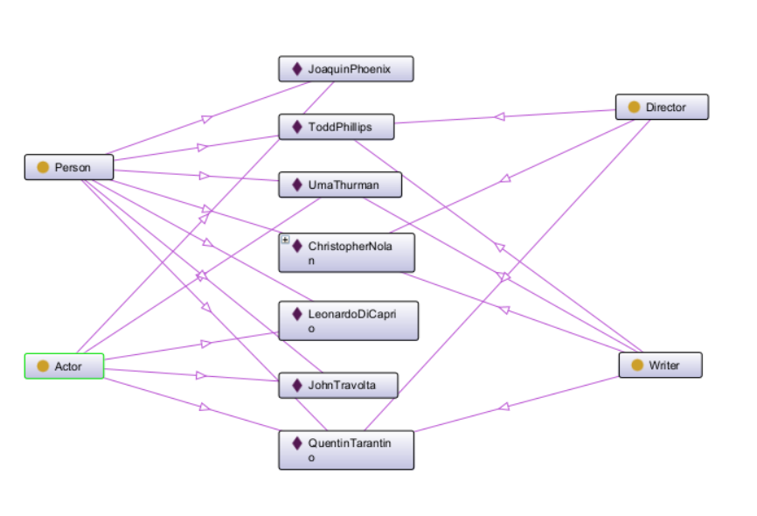

Slide 9
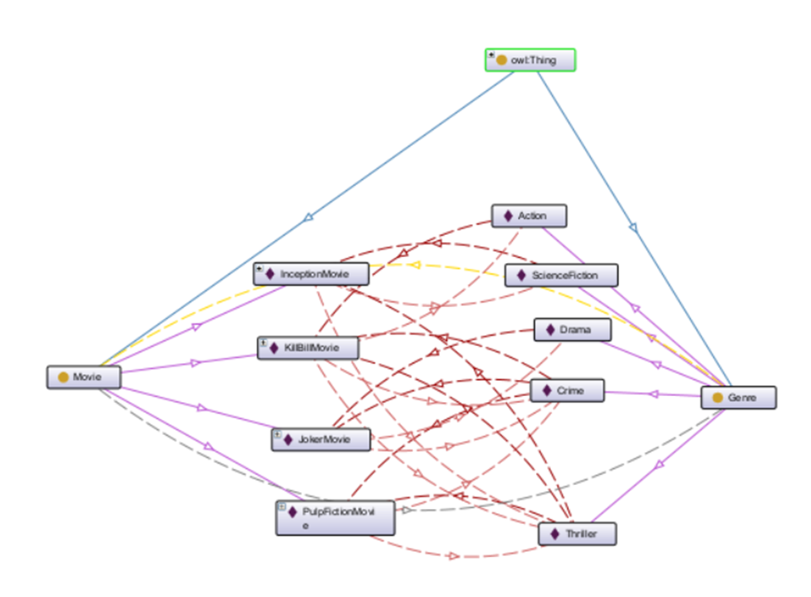

Slide 10
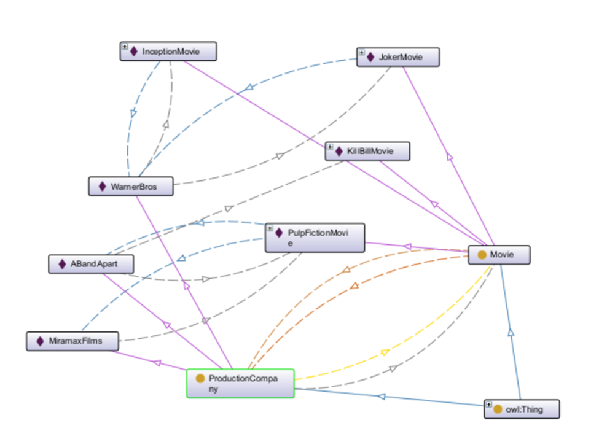

Slide 11
Queries & Results

Slide 12
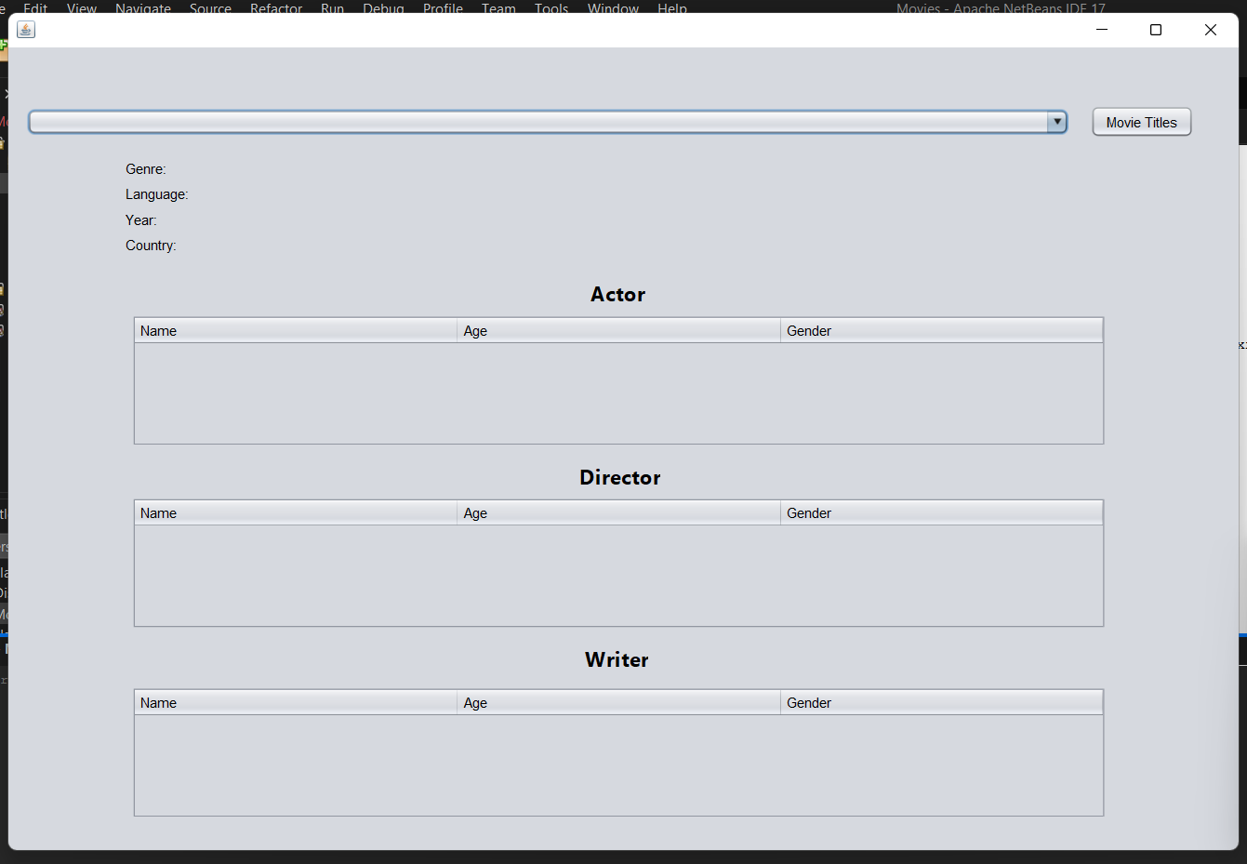

Slide 13
